Slide 1
Lecture
Cascading Style Sheets (CSS)
Internal Style Sheets
Classes

Slide 2
Types of Styles
Inline Styles – Styles that you type “inline” with each tag
<h1 style="text-align: center;">
Internal Style sheets: Styles are defined for each page
<style type="text/css">
h1 {
color: purple;
}
</style>
External style sheets: Styles are defined and linked to the entire site.
<link rel="stylesheet" type="text/css" href="style.css">

Slide 3
Using Internal Style Sheets
<html>
<head>
<title>This is a great page!</title>
<style type="text/css">
h1 {
color: purple;
}
</style>
</head>
<body>
<h1> Hello World! </h1>
<p> This is my <b>first page</b></p>
</body>
</html>
Style element is
inside <head> element
Style definitions go
inside <style> element

Slide 4
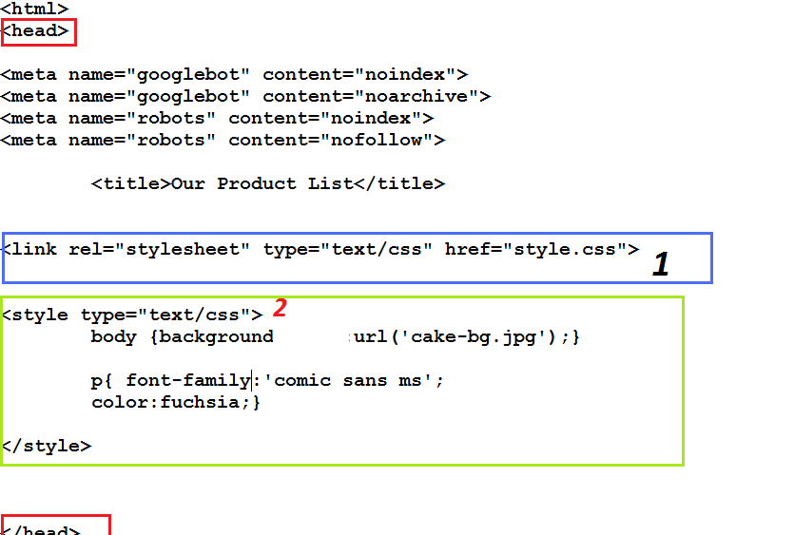
Placement of Internal Style Sheet

Slide 5
Using Different CSS Selectors
Type Selector(What we’ve been using…)
  redefines the look of a specific tag
  A type selector matches every instance of the element type in the document tree
  E.g. body {background-color: #000000;}
Class Selector (new)
  can apply to any tag
  E.g. .indent{margin-right:5%;margin-left: 5%;}
  In HTML, <p class=“indent”>
Notes:
pseudo-classes are used in CSS selectors to allow information external to the HTML source (e.g. the fact that an anchor has been visited or not) to classify elements.

Slide 6
Using Class Attribute Selectors
CLASS is an HTML attribute that assigns a class name to any HTML element on a web page.
Short cut to diversifying styles on your pages
Can be used to identify which style sheet rules should be applied for the particular element of a web page

Slide 7
Using the Class Attribute Selector
A class name is created by declaring a style rule in your style sheet and adding (.) flag character indicating that the selector is a class
.red {color:red}
.pink {color: #FF00FF}
Add it to the HTML code of a web page by using the CLASS attribute
<h2 class="red"> Company Description </h2>

Slide 8
Using the Class Attribute Selector
For color or style variety:
IN HTML CODE
Inline style:
<h1 style=“color: red">
Or Class (better!)
<h1 class=“red"> <p class=“red">
<hr class=“red"> <li class=“red">

Slide 9
Using Different CSS Selectors
When to use which?
  Use “type selector” when you want to apply certain style for all occurrences of a certain tag
  Use “class selector” if you want to apply the style for many (but not all) occurrences of a certain tag; OR if you want to apply the style for more than one type of tags

Slide 10
More Styling Options – DIV Boxes
HTML Tag – <DIV>
Creates a unique area on your webpage that can be styled with various indexes (like classes)
Can be used together to help layout specific pages with greater control and style
Everything in the box will have the same attributes
Notes:
The index is the same as a class except it is for elements like div boxes. Using the unique index you can style the div box for width, height, background, alignment, text, colors images etc.

Slide 11





DIV Boxes - Layouts
Page styled by page tag in CSS (Background)
White background set by DIV 1
Header area set by DIV 2
Navigation area set by DIV 3
Text area set by DIV 4
Left box area set by DIV 5
Footer area set by DIV 6

Slide 12
DIV Boxes - HTML
All controls for the div box are defined on the style sheet using this index
<div id=“wrapper”>
Information to include in the box or area – can be any web element including another div box
</div>

Slide 13
Example Indexes
#page {
padding: 5px 45px 15px 45px;
position: relative;
width: 890px;
margin: 0;
}
#foot {
background-color: #cdcdcd;
color: black;
font-size: 8pt;
text-align: center;
padding: 5px 25px 0px 25px;
position: relative;
width: 930px;
margin: 0;
}
#content-box1 {
width: 320px;
float: left;
}
#content-box2 {
margin: 0 0 0 335px;
width: 320px;
}
#wrapper {
position: relative;
width: 980px;
height: auto;
margin: 10px auto 10px auto;
background: #FFFFFF;
}
#header {
margin: 0px 0px 0px 0px;
height: 200;
position: relative;
padding: 25px 45px 25px 45px;
width: 900px;
}
#menu {
margin: 0px 0px 0px 0px;
height: 150;
position: relative;
padding: 0px 0px 0px 0px;
width: 975px;}

Slide 14
Understanding Classes
Classes & indexes
http://rainbow.arch.scriptmania.com/css/css_classes.html

